Slide 1
Working with geographical data
7MRFGA05: Air Quality Data Science
James David Smith
29th November 2018

Slide 2
Outline
Spatial data types
Storing spatial data
Coordinate reference systems
Geographical Information SYSTEMS
Displaying and querying spatial data
Sources of spatial data
GIS in ERG

Slide 3
Spatial data types

Slide 4
Spatial data types
Geographical representations of the world fall within this field are classified as either …..
Vector:
Data stored as either a point, a line, a polygon, or a line-string.
Typically 2-dimensions, but can be 3-dimensions (or 4 – time).
Has defined boundaries/locations
Raster:
Data is stored in regular gridded cells
Continuous values across the dataset (even if that value is no value)

Slide 5
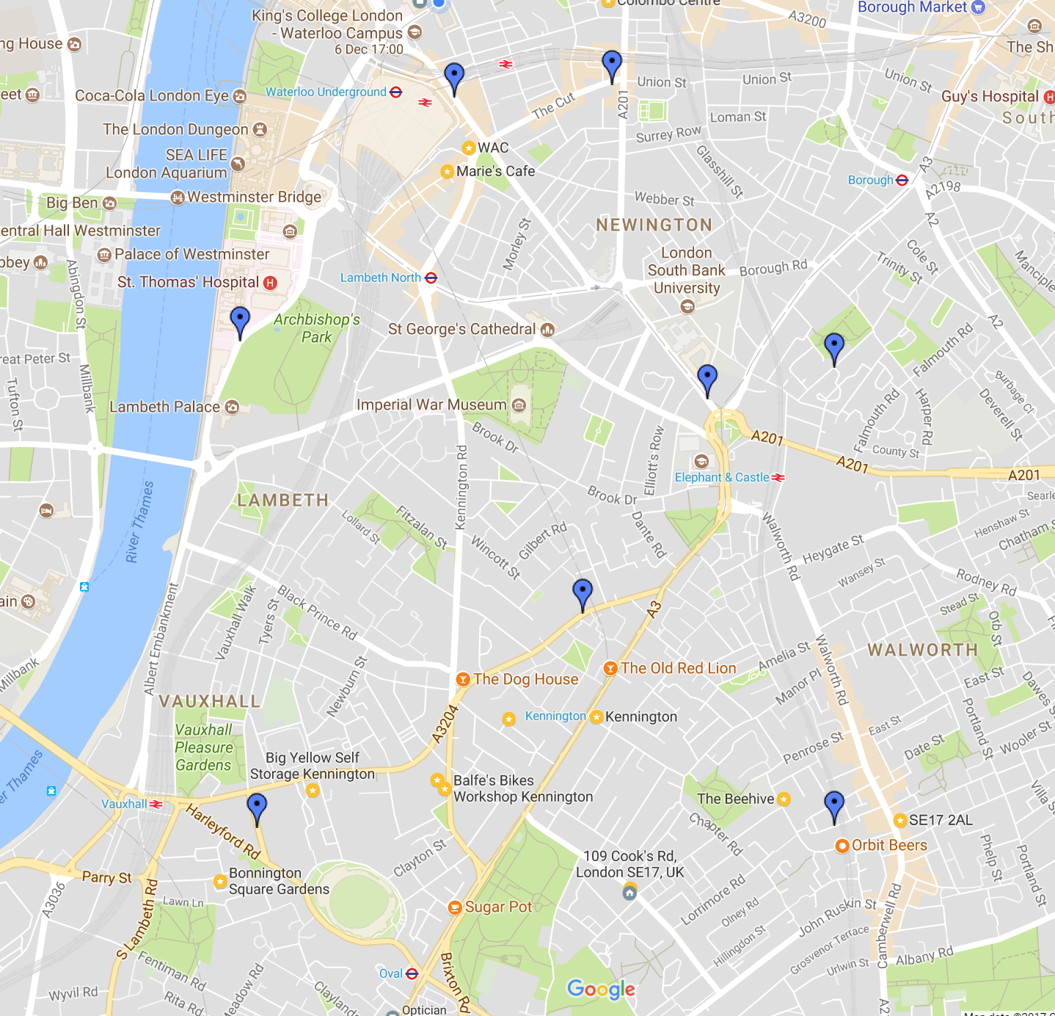
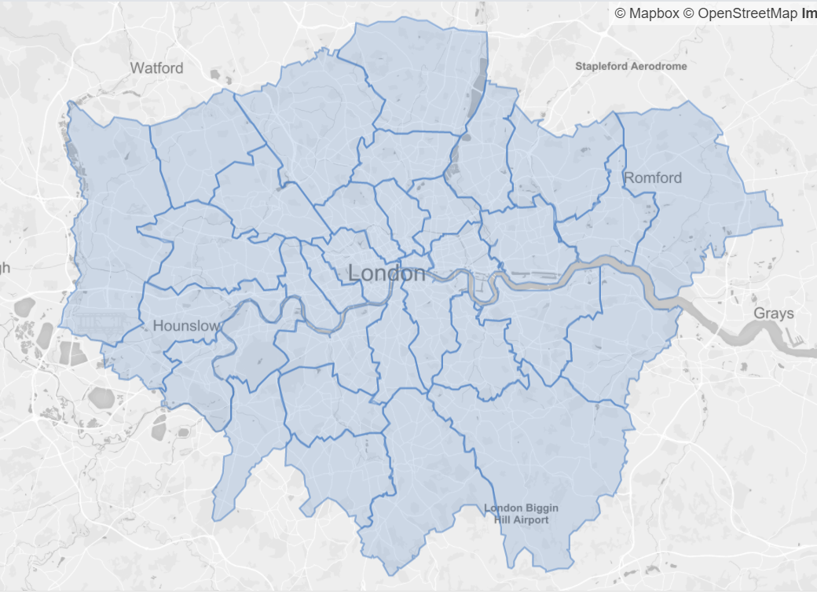
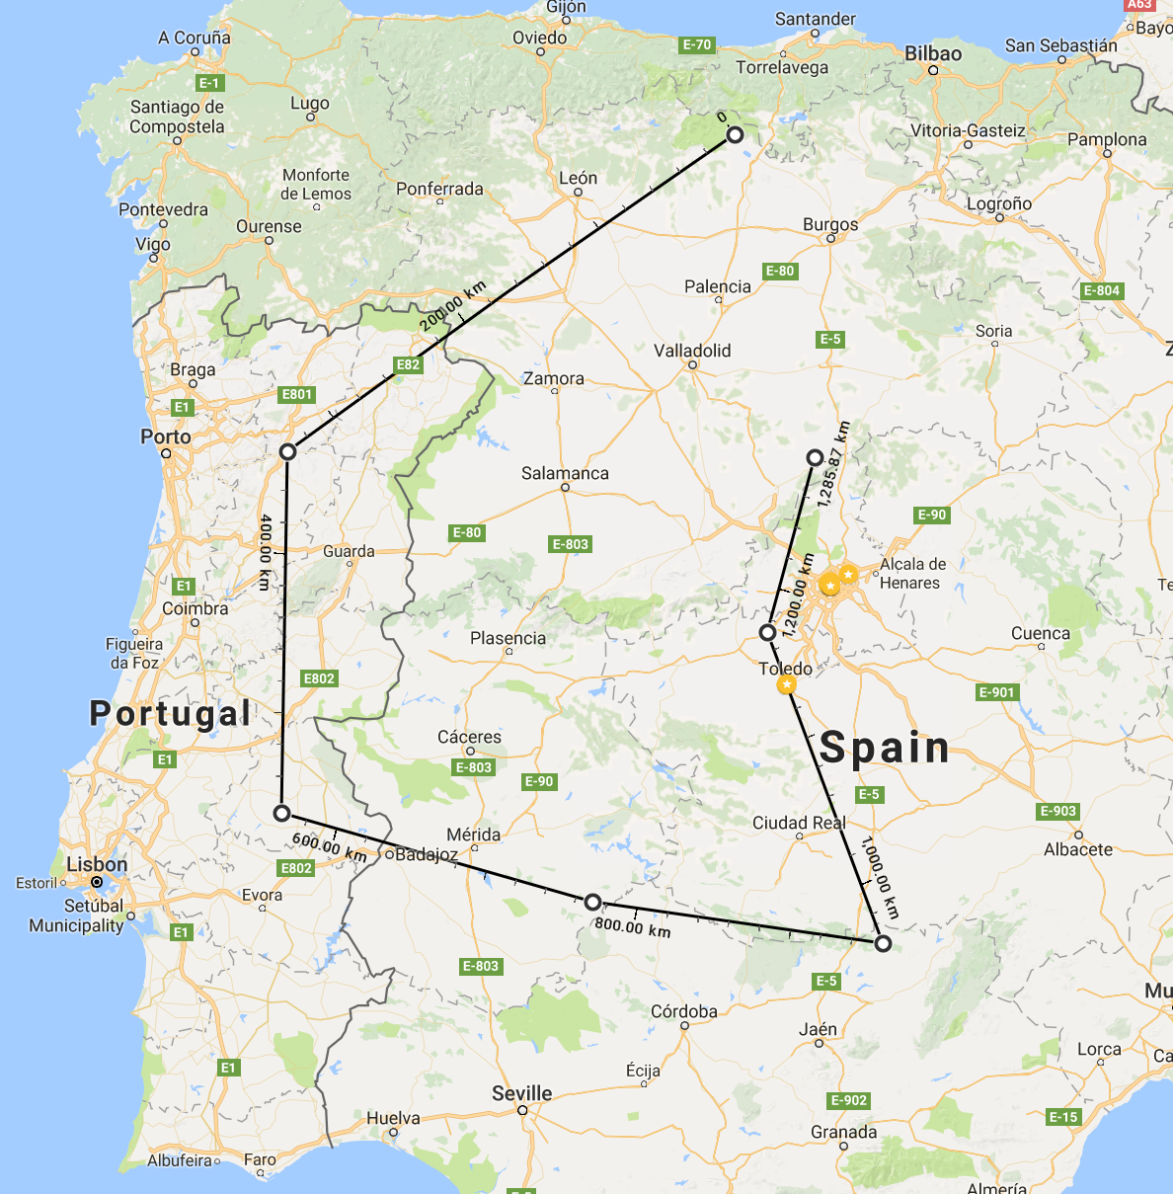
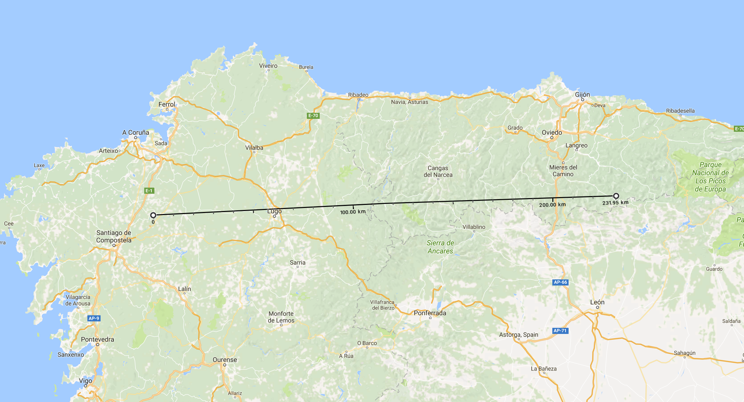
Spatial data types

Slide 6
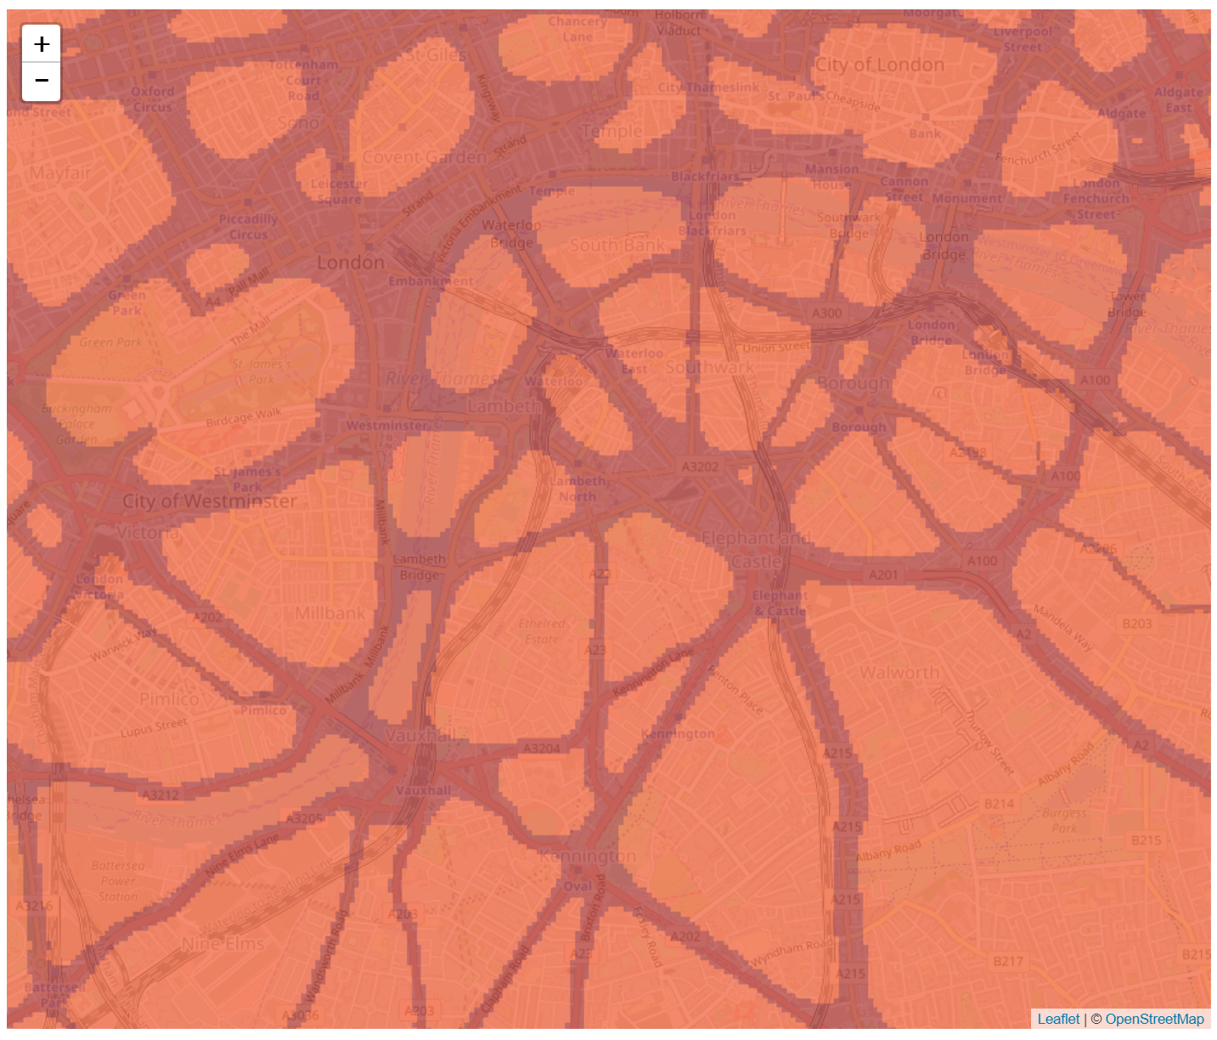
Spatial data types
http://www.londonair.org.uk/Research/custom/modelling-no2-pollution-in-the-uk.html

Slide 7
Spatial data types
In what format would the following things be stored as?
Location of a public swimming pool
The border of China
The London Underground network
Soil type of London

Slide 8
Storing spatial data

Slide 9
Storing spatial data
Spatial database (MySQL, PostgresSQL+PostGIS, Oracle Spatial, SpatialLite etc)
Comma-separated-values (CSV)
Java-script Object Notation (JSON / GeoJSON)
ESRI Shapefiles
MapInfo TAB files
ASCII (Raster)
TIF (Raster)
GeoPackages*

Slide 10
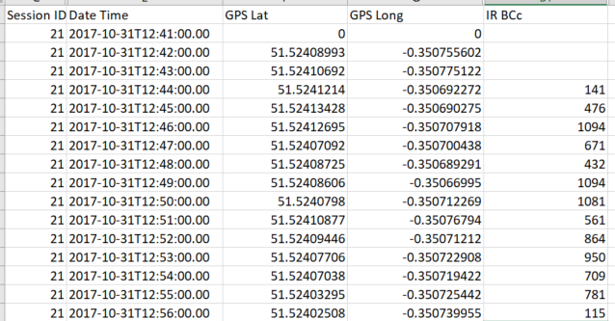
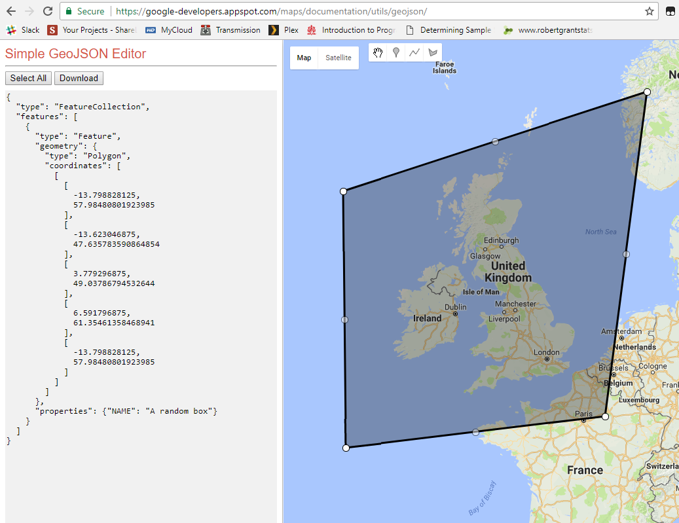
Storing spatial data
CSV Point data
GeoJSON polygon

Slide 11
Coordinate reference systems

Slide 12
Coordinate reference systems
A system of (normally) numbers used to locate an object within space.
Spatial Reference System (SRS) or Coordinate Reference System (CRS) are both used.
Many different systems are used around the world for different reasons.
https://www.youtube.com/watch?v=vVX-PrBRtTY
https://bl.ocks.org/mbostock/raw/3711652/
This is a whole academic discipline in itself, the take-home message is make sure you know what coordinate reference system your data is in.

Slide 13

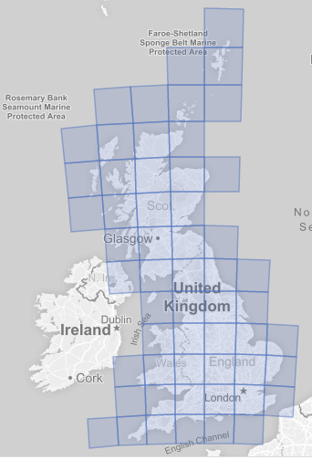
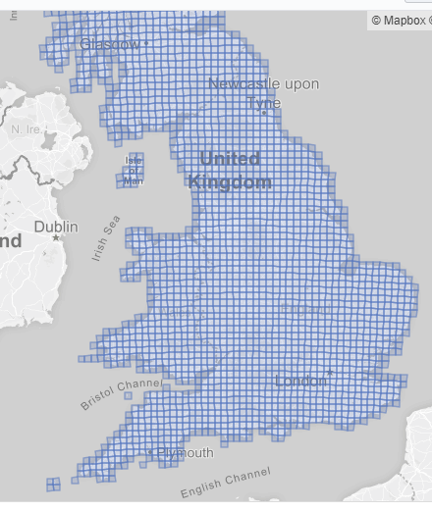
Coordinate reference systems
WGS84 – Latitude and Longitude, CRS 4326
OSGB36 – Easting and Northing, CRS 27700

Slide 14
GEOGRAPHIC INFORMATION SYSTEMS

Slide 15
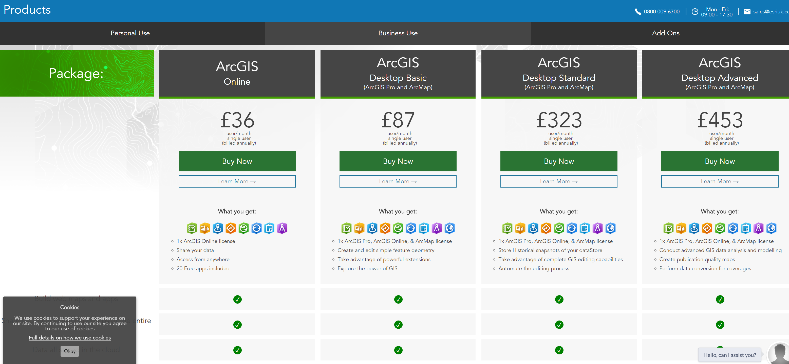
Geographic Information Systems
Used to display, query, manipulate, process spatial data.
Main ‘standard’ GIS environments that people work in:
ArcGIS
Now on Version 10, been around since 1999
The ‘industry standard’ GIS.
Data is stored as a Geodatabase or Shapefile
But it can* be expensive!

Slide 16

Geographic Information Systems
Quantum GIS
Free and open-source
User-made add-ons and libraries
Free
Active community development
Free
Did I mention it’s free

Slide 17
Geographic Information Systems
Increasingly GIS work is being done solely within programming languages such as R and Python.
Both have a wide range of spatial functions and libraries to extend their functionality
Python has the edge in terms of interacting with other software i.e. QGIS and ArcGIS both have Python-interaction natively built-in.
R is however widely used, especially within Academic (and ERG!).
R is the better language choice for wider data analysis and statistics (in my opinion)

Slide 18
Geographic Information Systems
Make a map using 5-lines of R code:
library(sf)
london <- st_read('https://raw.githubusercontent.com/KCL-ERG/useful_geography/master/london_boroughs.geojson')
pdf('C:/Users/james/Desktop/london.pdf')
plot(st_geometry(london))
dev.off()

Slide 19
Displaying and querying spatial data
Demonstration of QGIS

Slide 20
Web-based GIS
There are web-based geographic information systems, but they tend:
Lack functionality of a desktop GIS / programming language
Where is your data stored? In their cloud = £££
Uploading large files can take a long time
Displaying large files on a web-map can be slow for the user
Recommend using web-based GIS tools for simple interactions and presentation, but (for now) do your analysis and processing somewhere else.
Demo of uploading a GeoJSON to CartoDB

Slide 21
SOURCES OF GEOGRAPHIC DATA

Slide 22
Sources of Geographic data
https://www.ordnancesurvey.co.uk/business-and-government/products/opendata.html
https://digimap.edina.ac.uk/
http://www.naturalearthdata.com/
http://download.geofabrik.de/
https://data.london.gov.uk/dataset?format=shp&page=2
https://github.com/johan/world.geo.json/blob/master/countries.geo.json

Slide 23
GIS IN ERG

Slide 24
GIS in ERG
How do we use GIS in the modelling group of ERG?
Routing of journeys
Car counting from space
Emissions on roads
Policy applications (LEZ, LES etc)
etc
Notes:
Talk a little about these things

Slide 25
The end.
Any questions? Ask me.
james.d.smith@kcl.ac.uk

Slide 26
Contact details/for more information James Smith Senior Air Quality Scientist Environmental Research Group, Room 4.189, Franklin Wilkins Building, 150 Stamford Street, London SE1 9NH +44 (0)20 7848 4013 james.d.smith@kcl.ac.uk www.kcl.ac.uk/lsm/research/divisions/aes/research/ERG/index.aspx
© 2016 King’s College London. All rights reserved

Slide 27
Afternoon session notes
Health atlas. What does the data show us. Interpreting data. How can maps lie. Areas. Colours.
Advantages and disadvantages of different maps
Maps can lie; size of areas, locations, borders etc.
https://en.wikipedia.org/wiki/Cartogram
Don’t believe the hyperbole
Transport maps & cartographic principles – let’s look at the London Underground
Interpretation of maps – The Health Atlas
Smart people question things
Make your own map in R (optional)

